Slide 1
Welcome!
Year 4/5 Parent Information Evening

Slide 2
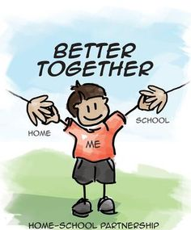
Meet the teacher!
Hello! I am Mrs Griffin – Panthers Class Teacher!

Slide 3
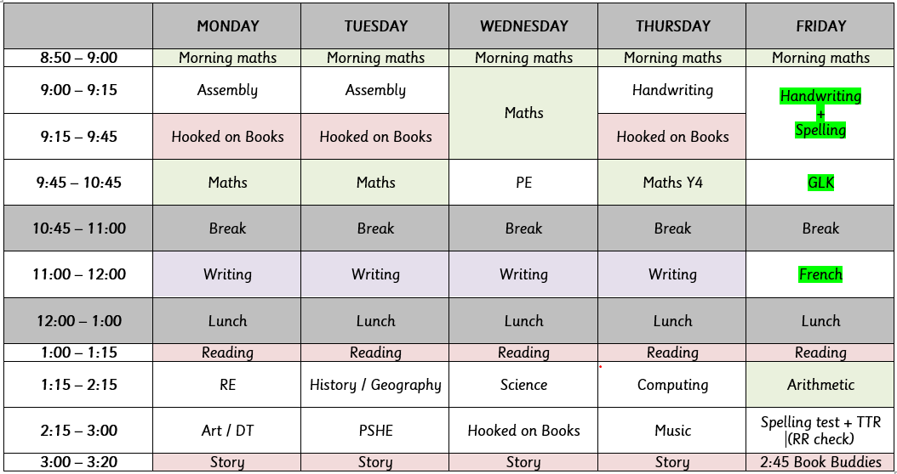
Timetable
What does a week in Panthers class look like?

Slide 4
Ways of keeping up communication
Check out the class blog to see what we’ve been up to each week (updated every Friday)
Newsletters have important dates on
If you need to talk to me:
Catch me at the door at pick-up time
Arranging a meeting if it is something of high importance

Slide 5
Our topics this year

Slide 6
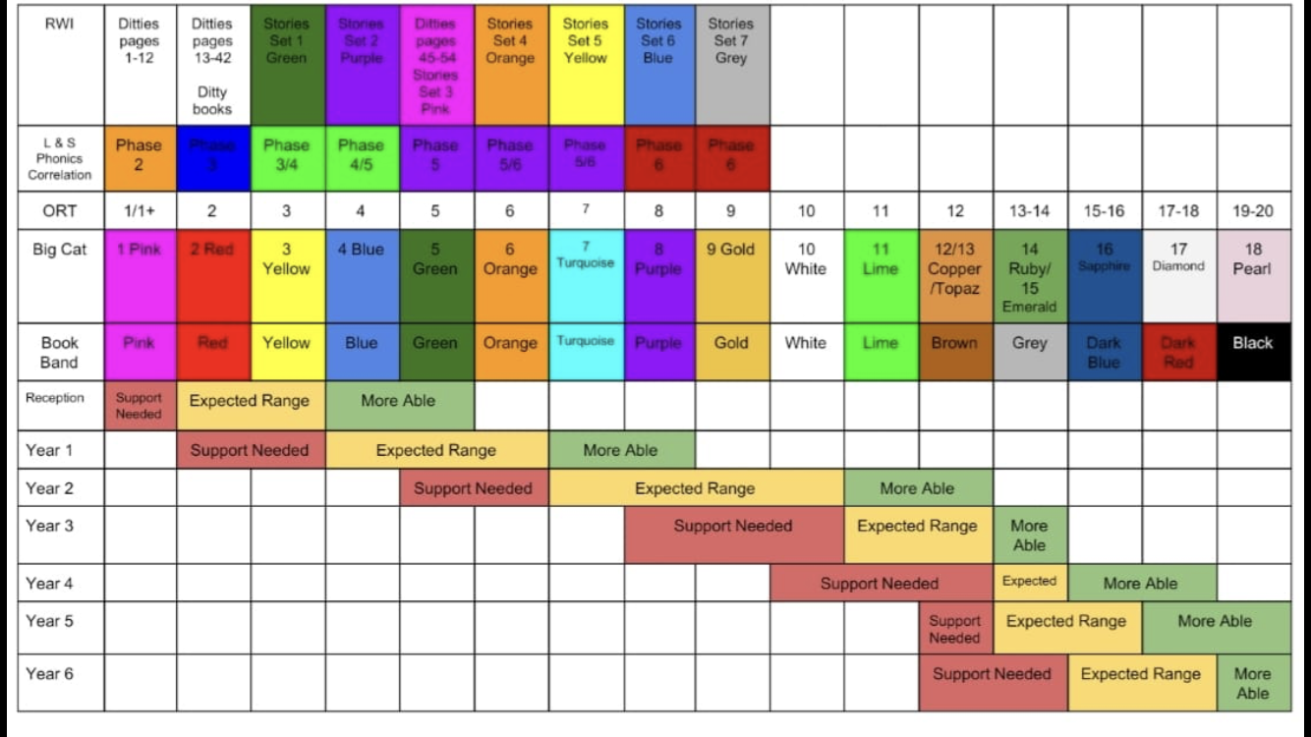
Banded books

Slide 7
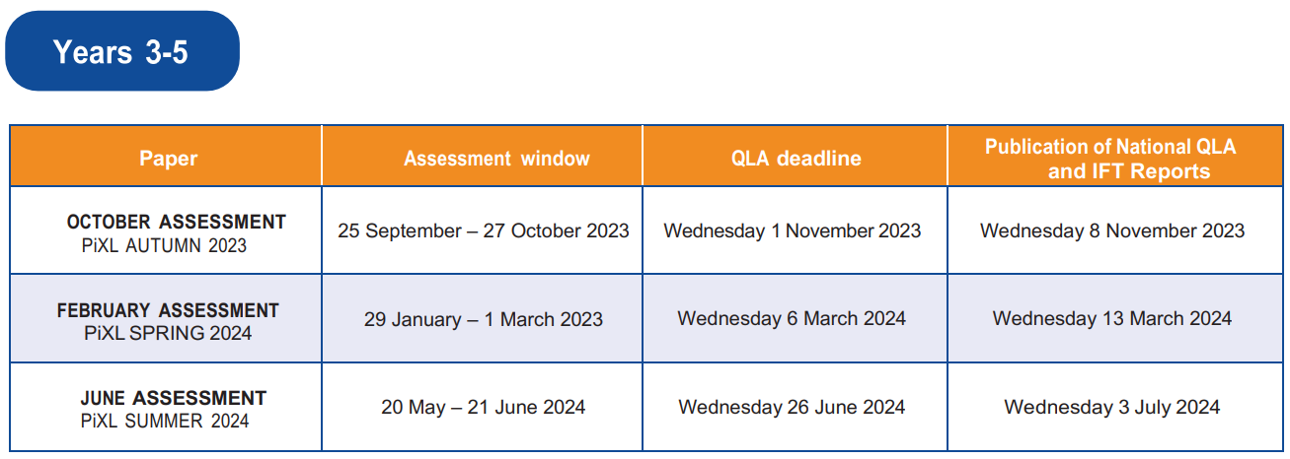
PiXL Assessments

Slide 8
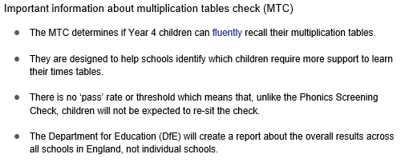
Y4 Multiplication Check

Slide 9
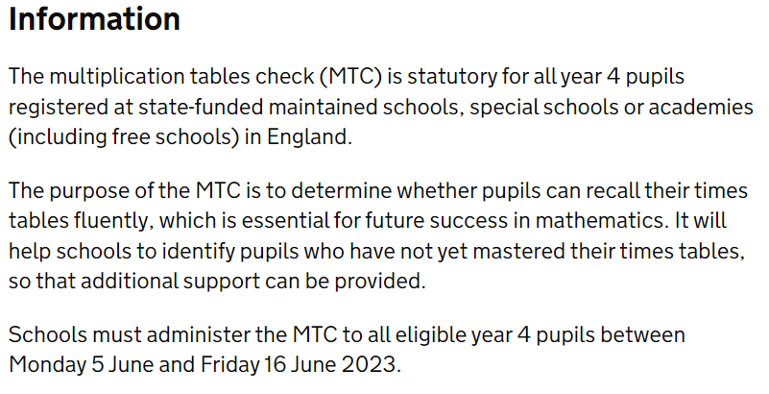
Y4 Multiplication Check

Slide 10
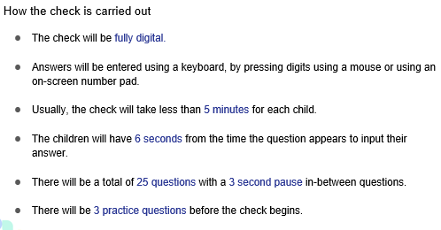
Y4 Multiplication Check

Slide 11
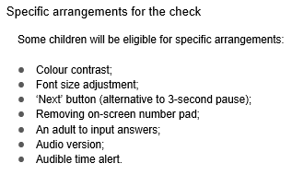
Y4 Multiplication Check

Slide 12
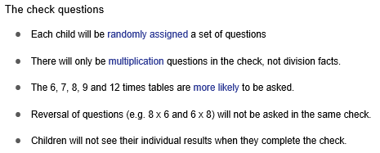
Y4 Multiplication Check

Slide 13
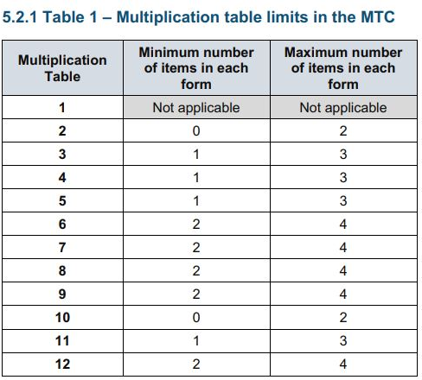
Y4 Multiplication Check
The table shows the minimum/ maximum number of questions from each times table that will be asked.

Slide 14
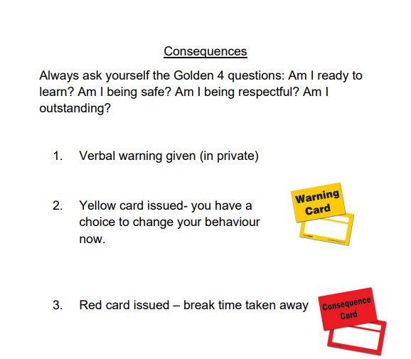
Behaviour management
Children are awarded with house points and recognition points and are praised for good examples of behaviour.
We are also continuing to award children as ‘Learning Champions’ each week.

Slide 15
Useful information
PE days: Wednesday and Friday. If your child wears earrings, please ensure they can take them out independently and have a safe place to store them during PE.
Class blog: https://www.bozeat.northants.sch.uk/class-blogs/panthers-home-learning-page/
Homework grids: Given out in Autumn 2 (after half term in October) - this will link to our topic of the Rainforest
Spellings: 10 spellings per week. Given out on Fridays to be practised for the test the following week. Children are also sent home with practise sheets.
Reading logs: I check these weekly on a Friday so please ensure children bring them on this day.

Slide 16
How to support your child’s learning at home
We encourage children to spend at least 10 minutes each, per day, practising their spellings, times tables and reading at home. Just half an hour a day makes a huge difference!
You can support this by ensuring children:
complete the spelling practise sheets and return them to me
help children access TTRockstars to practise times tables
complete their reading logs to show me how much they have read each week

Slide 17
Any questions?
Thank you very much for attending this evening!

